Slide 1
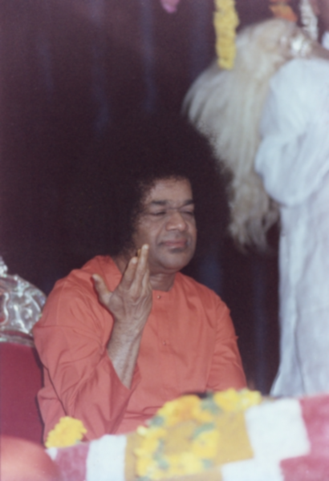
Gana Lola
Chapter-4

Slide 2
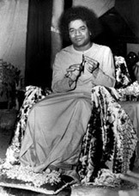
“Those Who Heard His sweet voice spread the news that a fine musician has come to town. ‘Prayer Songs’ at functions like public meetings became his monopoly thereafter”

Slide 3
Swami’s Brother
Sheshama Raju, the elder brother marries the daughter of Pashupati Subba Raju
Swami had decided to go to Kamalapur.
His parents wanted him to become an officer

Slide 4
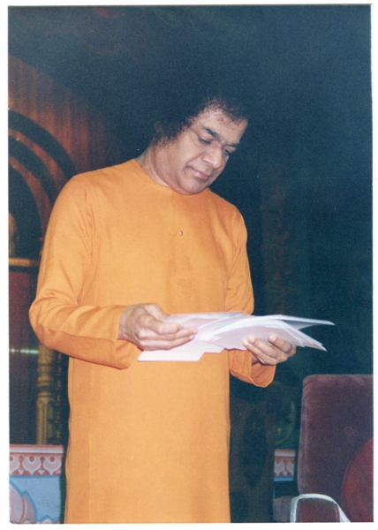
Question 1
Where did Swami decide to go for his higher learning?
Answer: Kamalapur

Slide 5
Swami’s Life at School
Swami was “a quiet and well behaved boy”
He was a proficient singer
The Scoutmaster was anxious about swami joining the troop
The scoutmaster incentivized swami directly and through his friends to get him on-board the troop
To demonstrate and inspire his friends about Seva and Prema, Swami joined just before cattle fair at Pushpagiri

Slide 6
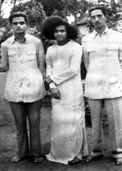
Question 2
What did he want to inspire his friends about?
Answer: Seva and Prema

Slide 7
Swami’s Trip to Pushpagiri
Swami walked as he didn’t have a pie
He humbly slept by the banks of the river, unluckily to find his bag missing in the morning
He found an anna on the rock by the banks of the river
He took the coin to a man who sat in front of a contraption
He earned 12 rupees that would be sufficient for him
Swami sold his old class book to a poor boy not for 12 rupees but 5 rupees
He walked back to Kamalapur as he had not paid to bus fair.
He only required 5 rupees to travel within Pushpagiri.

Slide 8
Question 3
What did Swami find on the rock?
Answer: He found an anna

Slide 9
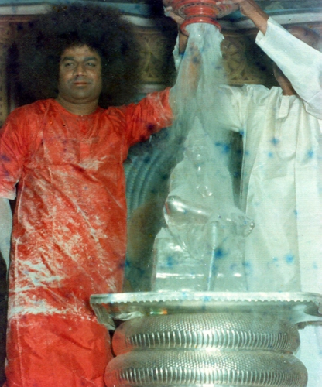
Swami’s Miracles
He had a miraculous power not only of feeding himself but others too
He entered enthusiastically upon his task of inspiring his classmates to do selfless social service.

Slide 10
Swami’s and Kote Subbanna Relationship
He wrote songs for the well known merchant, Kote Subbanna.
Morning:
He would catch swami on the way to school and provided information on his new article
Evening:
He wrote beautiful songs for Subbana by evening
Swami was ready with an attractive song , stuff in poetry.
These songs were sung by the band of urchins
These songs started dancing on every tongue!

Slide 11

Question 4
Who sung the songs?
Answer: The band of urchins

Slide 12
Swami’s Manifestations
The large number of public receptions and Pooja they organised to “Bala Sai” after his return to Puttaparthi.
His brother completed his training, posted as a teacher at the high school at Uravakonda.
He manifested himself at Uravakonda, but spread his glory from Kamalapur.

Slide 13
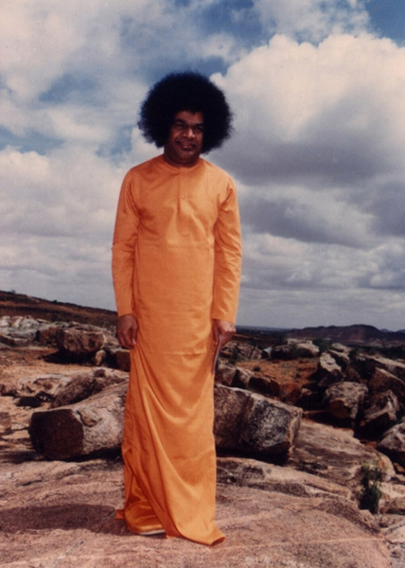
Question 5
Where did he manifest himself at?
Answer: Urvakonda

Slide 14
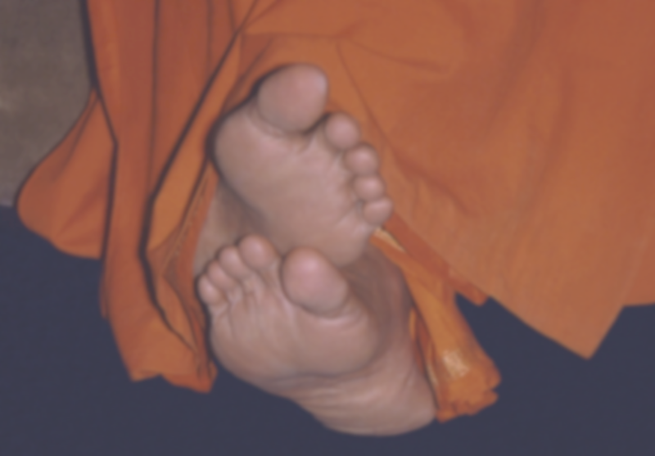
Thank You, Sairam!

